Slide 1
AI-Powered Code Reviewer – Milestone Progress Presentation
Automated Code Documentation and Quality Analysis Using AI
–By Anushika L

Slide 2
📌Milestone 1: Requirement Analysis & Code Parsing:
Problem Statement:
Many software projects lack proper documentation, especially docstrings in Python code. This makes the code hard to understand, maintain, and reuse. Writing docstrings manually is time-consuming for developers.
Objective of the Project:
To automatically analyze Python code
To identify functions without proper documentation
To assist developers using AI-based suggestions
To improve code readability and maintainability

Slide 3
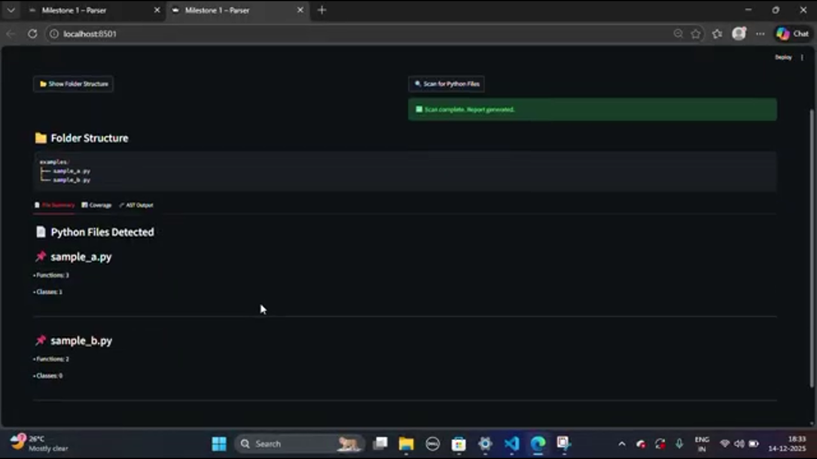
Requirement Analysis:
Functional Requirements:
Scan folders to find Python files
Extract functions and existing docstrings
Detect missing or incomplete documentation
Support multiple docstring styles
Non-Functional Requirements:
Simple and user-friendly interface
Fast execution
Reliable and accurate results

Slide 4
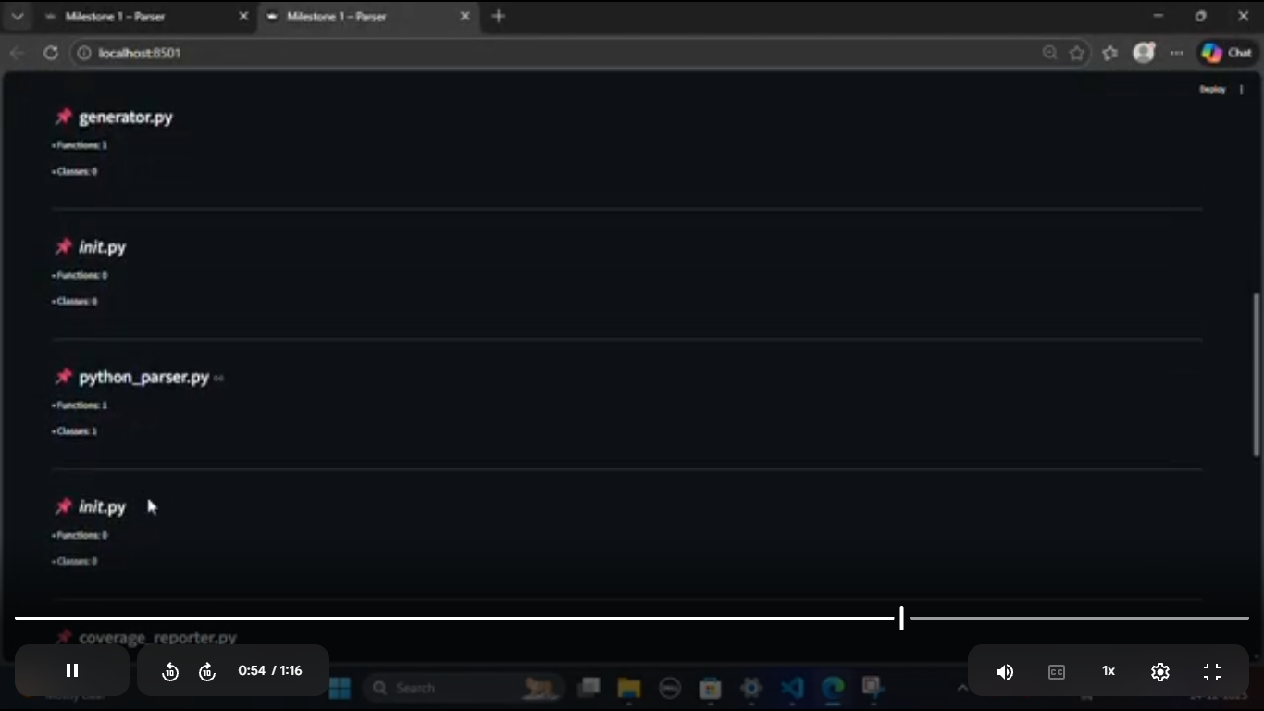
Code Parsing Process:
Code Parsing Approach:
The system uses Python’s AST (Abstract Syntax Tree) to analyze source code without executing it.
Key Steps:
Read .py files from the project
Identify function definitions
Extract function name and docstring
Store the details for further analysis

Slide 5
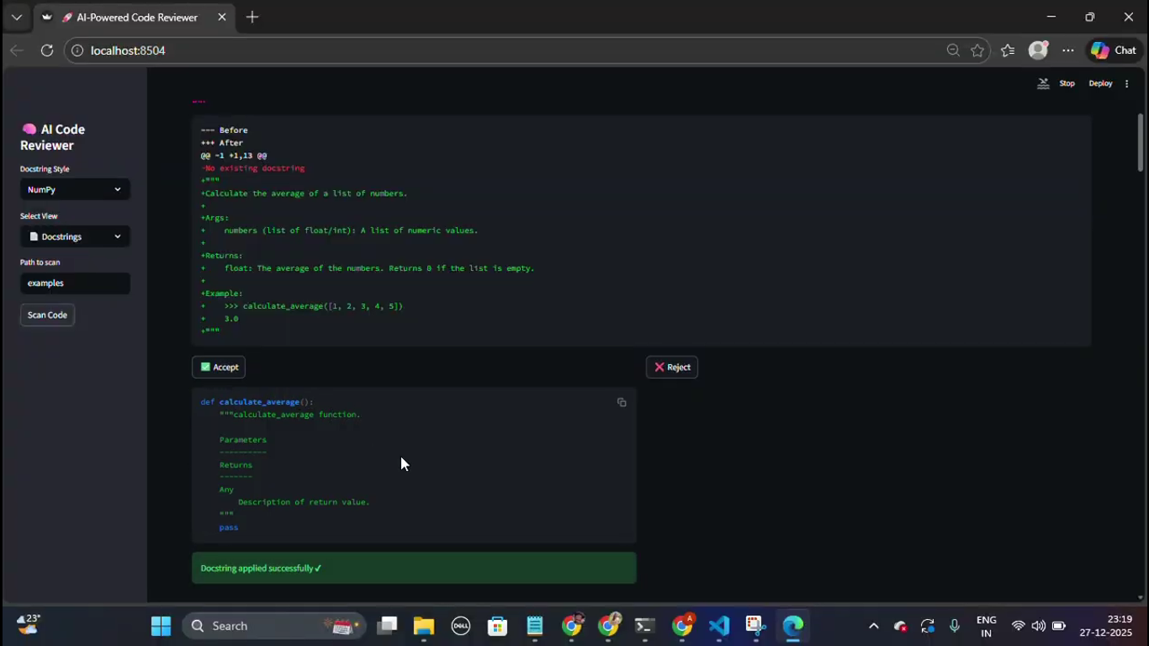
📌 Milestone 2: AI Docstring Generation & Validation:
AI-Based Docstring Generation:
AI Integration:
Artificial Intelligence is used to generate meaningful docstrings automatically based on function logic and parameters.
Features:
Automatic docstring suggestions
Clear description of function purpose
Standard format support

Slide 6
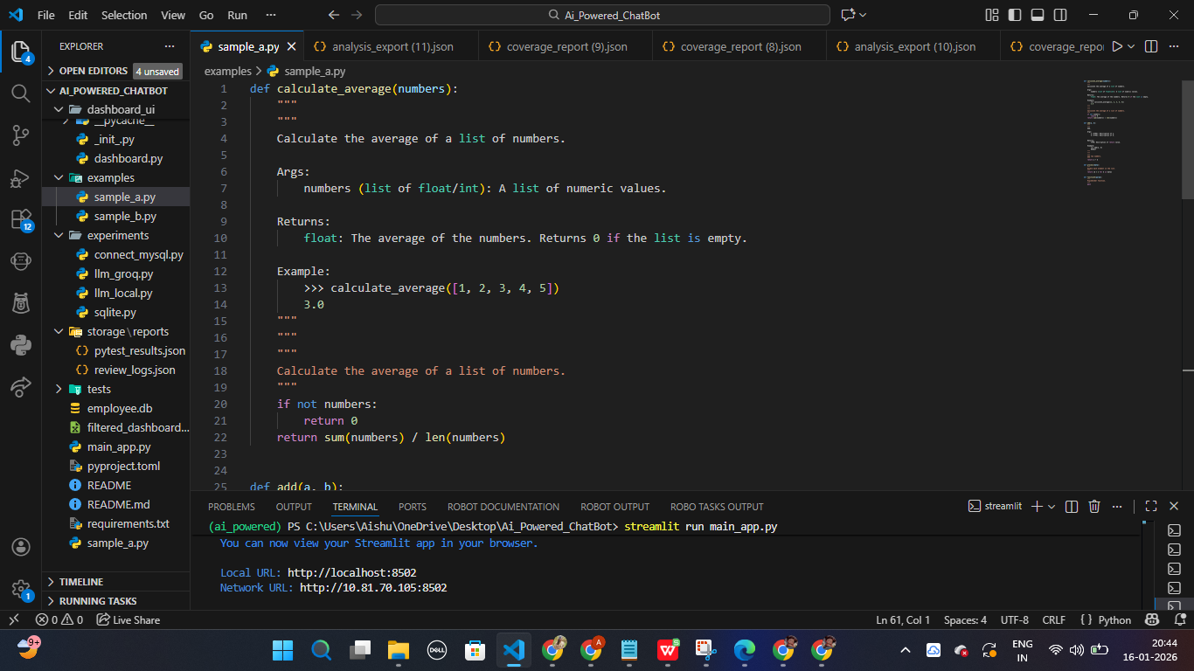
Docstring Validation:
Validation Process:
The generated docstrings are checked for completeness and correctness.
Validation Includes:
Function description
Parameters explanation
Return value description

Slide 7
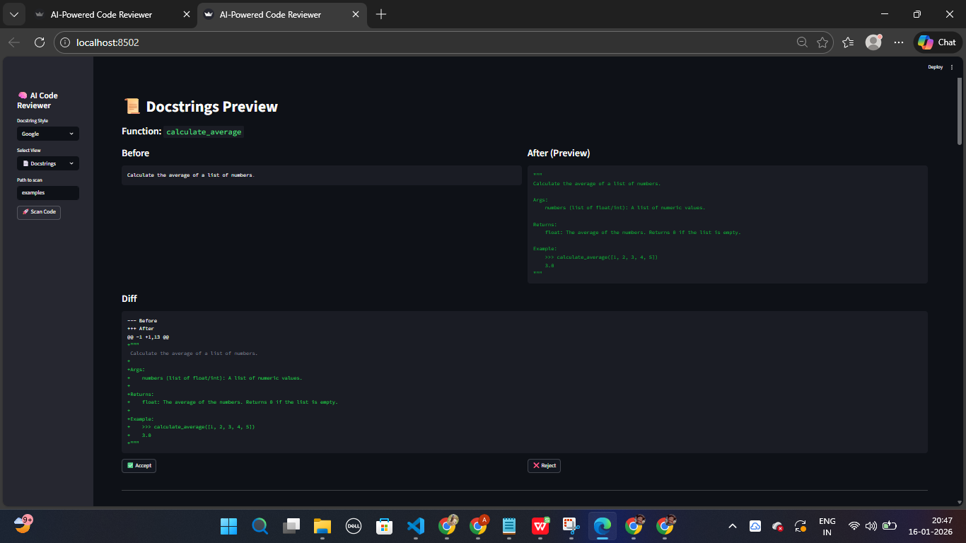
User Review Process:
User Control:
Users can view existing and suggested docstrings
Differences are clearly shown
Users can accept or reject changes.

Slide 8
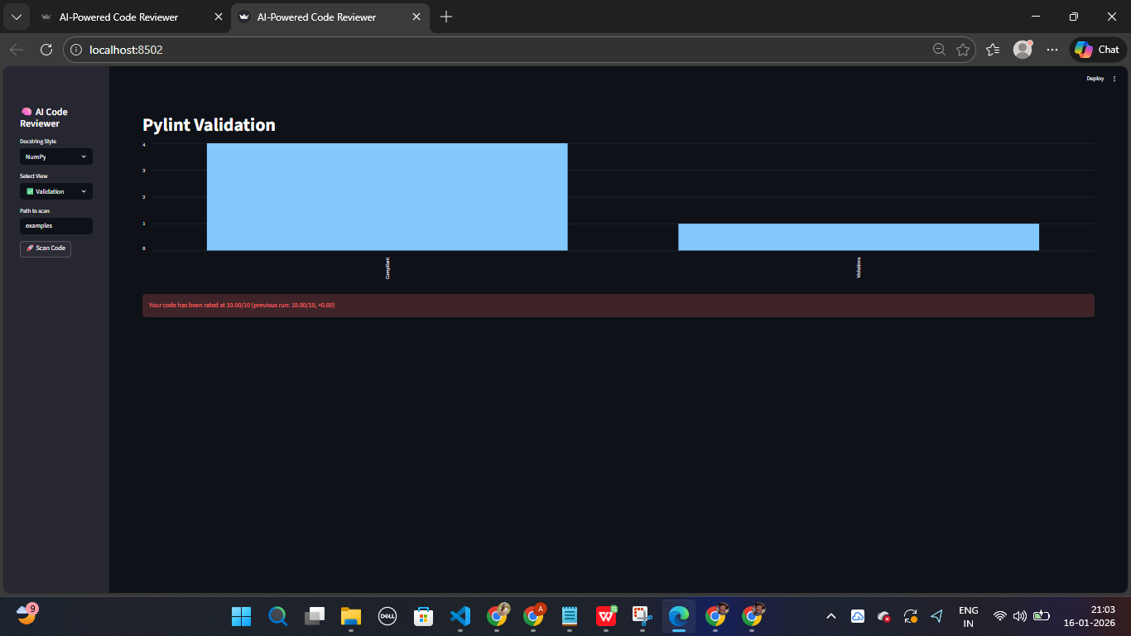
📌 Milestone 3: Code Quality Analysis & Testing:
Code Quality Analysis:
Quality Checking:
Pylint is used to analyze code quality and coding standards.
Metrics:
Number of violations
Documentation coverage
Code consistency

Slide 9
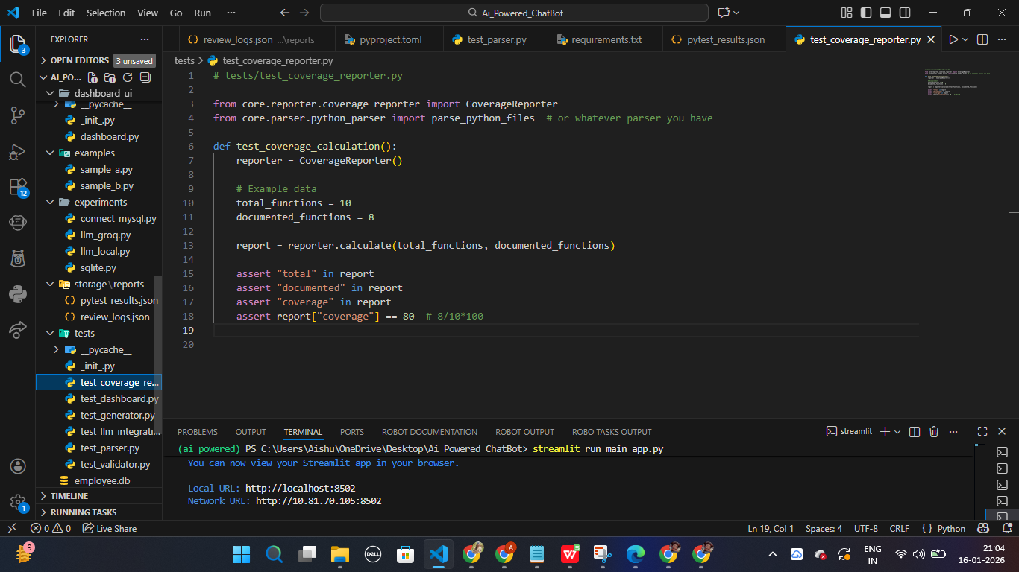
Testing Strategy:
Testing Tool:
Pytest is used for automated testing.
Test Coverage:
Code parser
AI reviewer
Validation modules

Slide 10
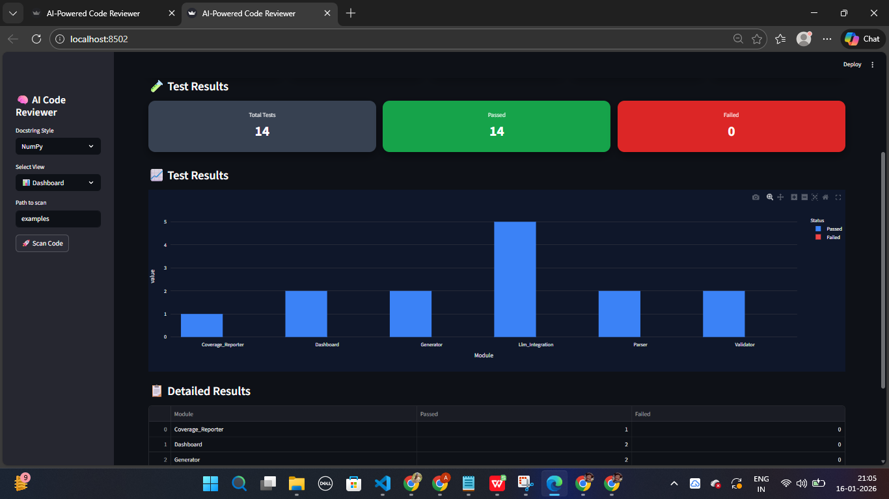
Test Results:
Results Displayed:
Total tests executed
Passed and failed tests
Module-wise performance

Slide 11
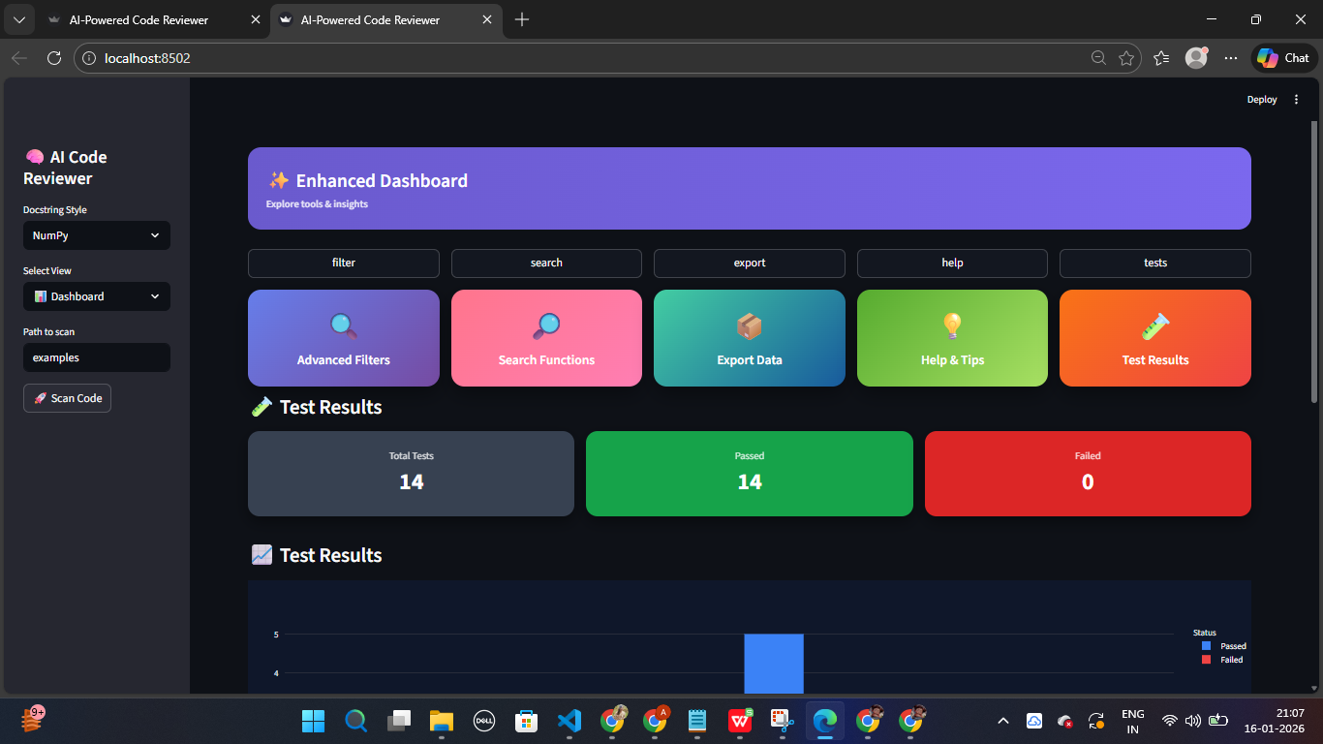
📌Milestone 4: Dashboard & Finalization:
Dashboard Design:
User Interface:
An interactive dashboard is created using Streamlit.
Dashboard Features:
Summary cards
Charts and reports
Easy navigation

Slide 12
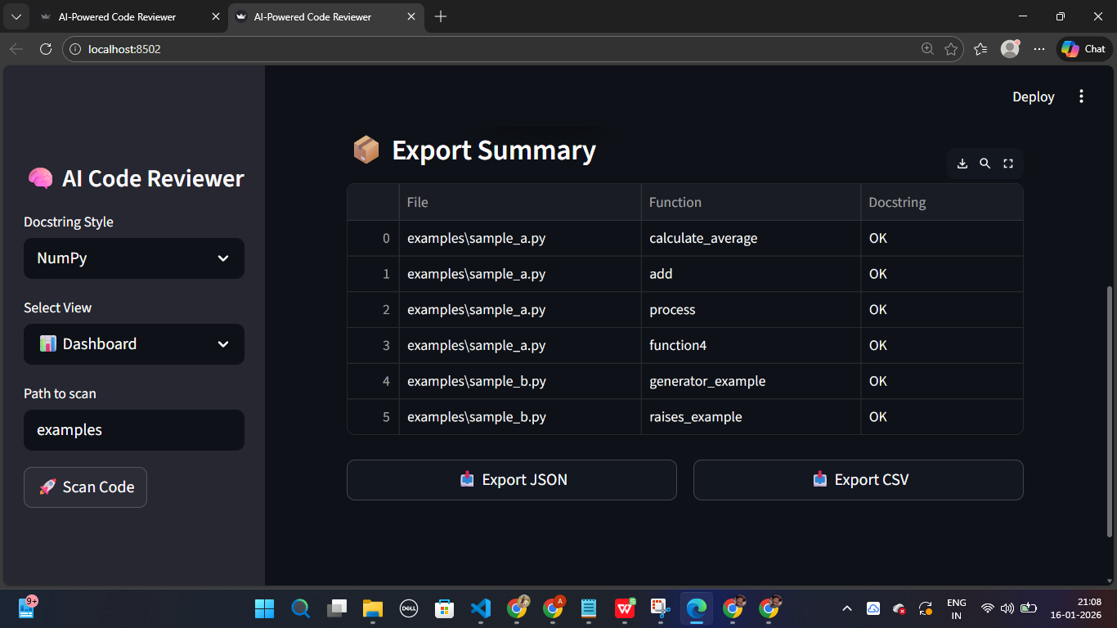
Export & Reports:
Export Options:
JSON
CSV
Usage:
Documentation
Project evaluation

Slide 13
Final Outcome & Future Scope:
Final Outcome:
Improved documentation quality
Reduced manual effort
Better code understanding
Future Enhancements:
Support for more languages
CI/CD integration
Advanced AI analysis

